Slide 1


West Region Sales Performance Analysis (2022–2025) EmporiUM Hana Tilahun Year Up United Data Analyst Capstone 3 06/25/2026

Slide 2
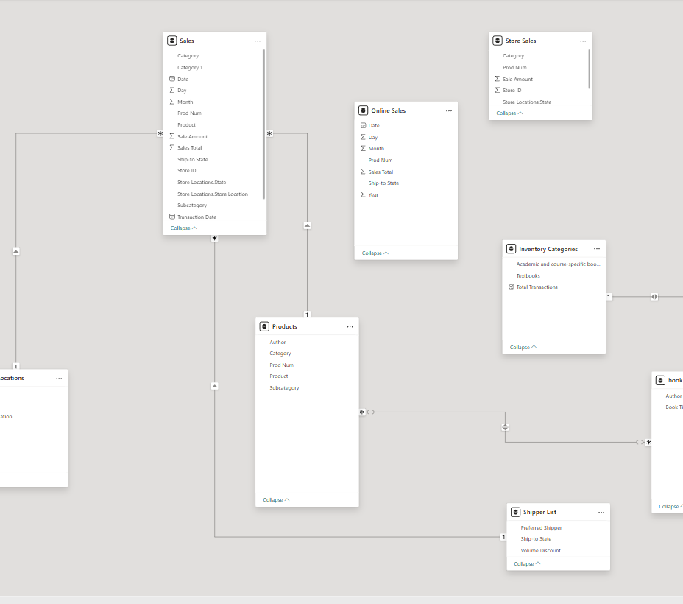




Business Objective Analyze West Region sales Combine store and online sales Identify sales trends Compare book categories Discover top-selling books Support business decisions

Slide 3
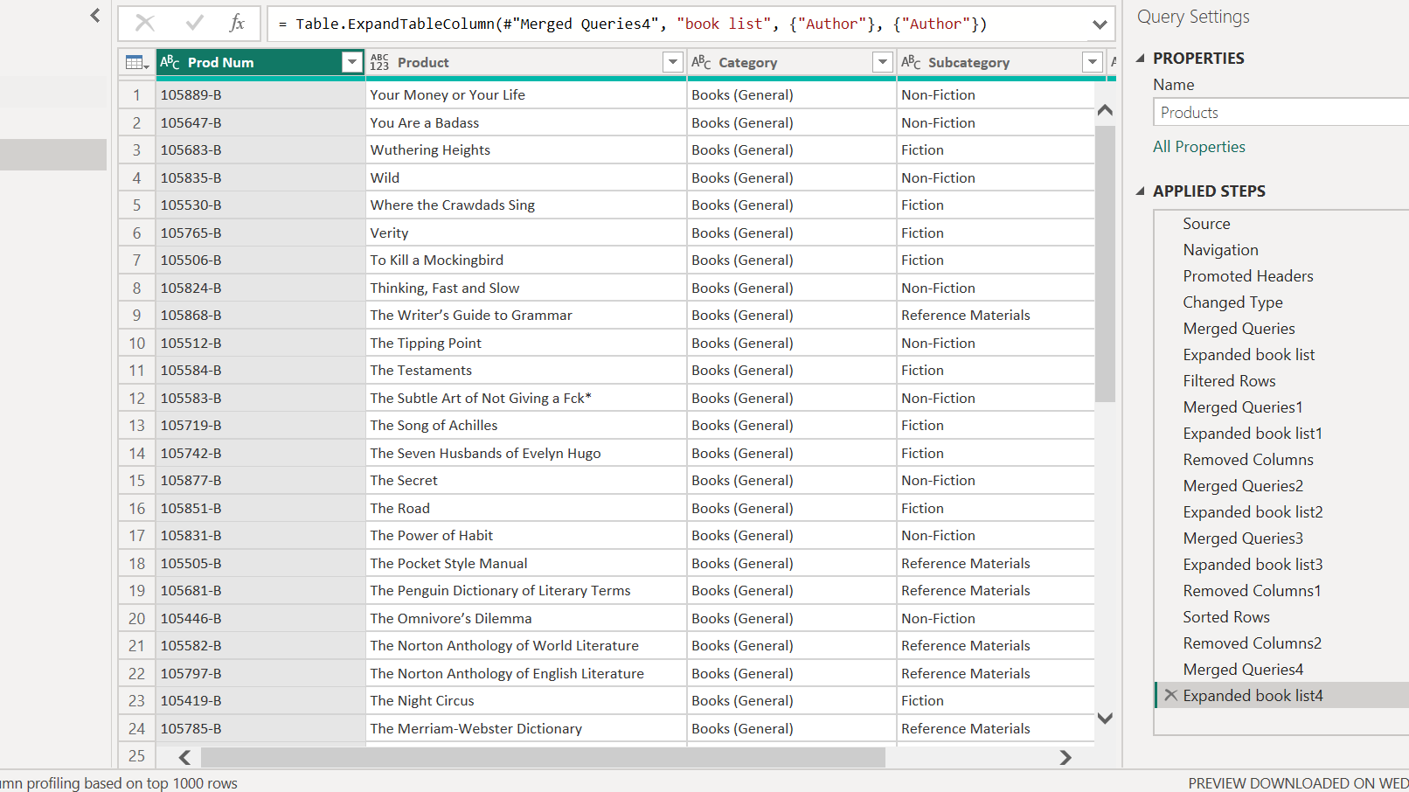
Data Preparation and Modeling
Imported Excel data
Cleaned headers
Created Date column
Appended Store + Online Sales
Created relationships
Merged Products
Added Authors

Slide 4
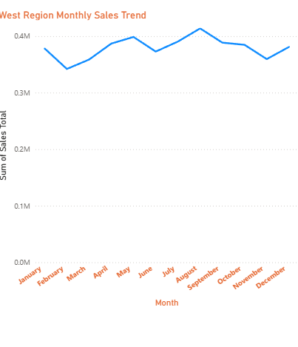
Monthly Sales Trend (2022–2025)

Slide 5
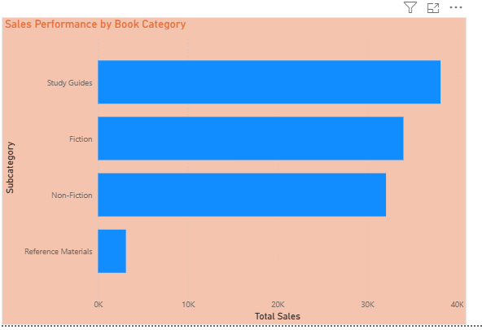
Sales by Book Category

Slide 6
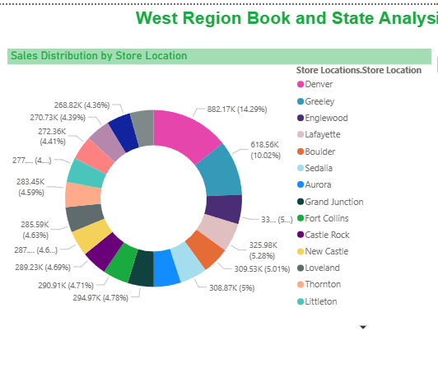
Sales Distribution Across Colorado Store Locations

Slide 7
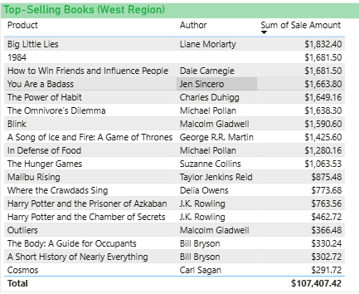
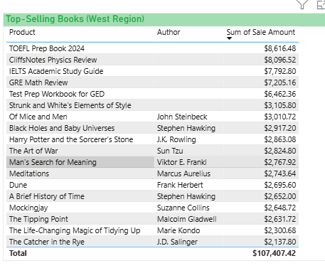
Best-Selling Books

Slide 8
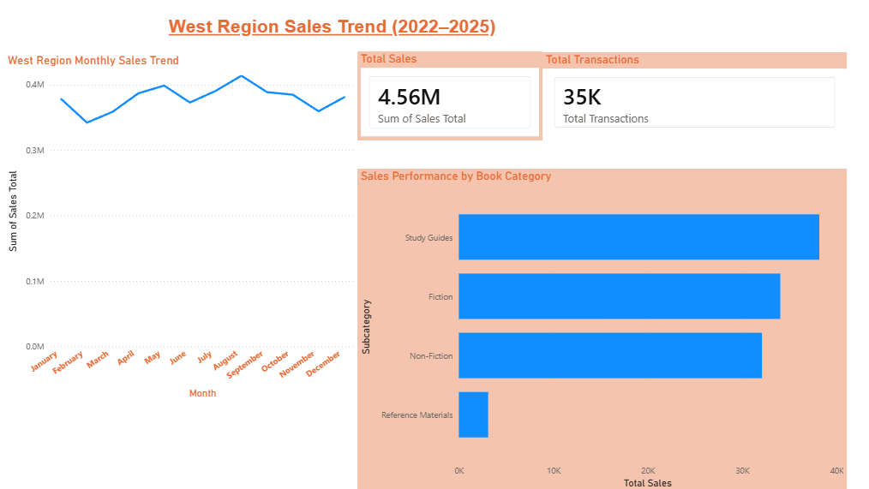
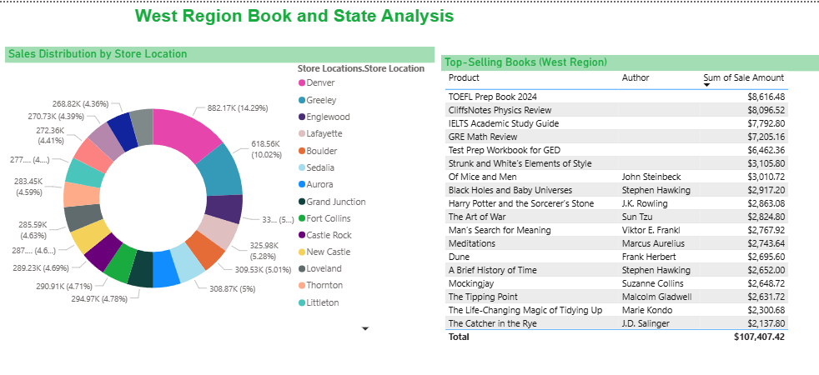
Continue investing in Study Guides. Increase inventory for best-selling books. Analyze high-performing store locations to identify successful practices. Promote lower-performing categories through targeted marketing. Continue monitoring monthly sales trends for seasonal
planning.
Business Recommendations & conclusion

Slide 9
Git Hub https://github.com/HanaETilahun/Capstone_3 Power BI https://yearuptemp-my.sharepoint.com/:u:/g/personal/htilahun_my_yearupunited_org/IQBtpPaW0XsQSayohL4RV8_WAR0fzmZyczfk2pWDHb4ewgU?e=gFiLxy

